Slide 1

DEPARTMENT OF MECHANICAL ENGINNERING
BATCH :- 12
Project Title :- Automatically recharging Electric Vehicle
Guided By:- Dr Manohar .H.S
Team Members:- Ganesh ( 1DT17ME018)
Rahul Gowda C S ( 1DT17ME055)
Ramaswamy D Malagatti ( 1DT17ME058)
Shankareppa Desai ( 1DT18ME 450)

Slide 2
Content 1. Abstract 2. Introduction 3. Literature Review 4. Objectives 5. Methodology 6. Progress of work 7. Conclusion

Slide 3
Abstract
This paper presents an intelligent energy management for electric vehicles (EVs) which contains automatic charging mechanism. Nowadays EVs charging the battery pack by using road side stations, park stations etc. to increase the travel time. To overcome this problem we have proposed an automatic charging with an Based on the principle of the Electromagnetic Induction , we transform the front wheel of the EV into a system by positioning the magnetic field and the conductor in it, where the magnetic field is varying and the conductor is stationary or vice versa. When the EV is in motion, the wheel is also in motion. So the magnetic field around the conductor varies which generates an EMF (electro motive force) and current is generated. This current can be used in recharging the same battery or the backup battery used for other purposes. This recharging of the battery will for sure increase the travel range of the EV and save the battery cycle life

Slide 4
India is fairly a big country among all Asian countries, so as huge amount of population. And in upcoming era pollution will also grow proportionally. Concerning about pollution caused by bikes will also increase. A survey claimed that in upcoming years 80% of fuel vehicles will be replaced by electric vehicles. The use of electrical vehicles to make India “pollution free”. There are many electrical bikes now on road to implement an idea claimed as pollution free. Pollution free is not only the term comes under consideration but also the consumption of power. Increasing rate of electric vehicles are having directly proportional relationship with more amount of power generation. The study of rate of power consumption will help to have a big picture of how much amount of power should be more generated.

Slide 5
Introduction
Global warming and scarcity of traditional resources are becoming major problems in the current scenario. Due to the economic challenges India is faced by the automotive sector the EV has a huge growth potential. People try to move towards "clean" energies. These facts among others will leverage the electric bicycle industry on the top of the agendas not only in India. Electric Vehicles are going to be the future trend and will definitely dominate the Automobile industry. When it comes to an Electric Vehicle, the efficiency and performance of the battery used becomes very important, which is also the deciding factor of the travel range of an EV once charged. So our purpose is to self-recharge the battery of the EV while in use. This will give us an improvement in the travel range of the EV and will reduce the frequency of charging the battery and which in turn increases the battery cycle life. Petrol prices are unpredictable, the price will increase or decrease will totally depend on the demand rate and production rate. And countries like India every second person’s choice for vehicle is bike because it reduce the time consumption and as well less maintenance

Slide 6
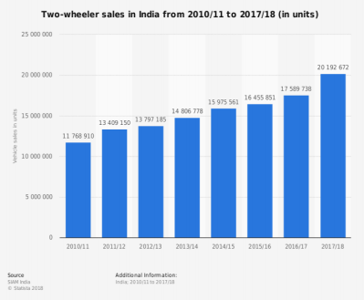
In India glut of bikes consume petrol and so the price of petrol will increase rapidly depending upon the production demand. The problem related with can be supplanted by introduction of e-bikes in India. Some companies already introduced e-bikes on road and advantage of it is, they don’t need petrol, instead of that as the name suggest it needs electricity for charging and by one time charging it can go almost 500km bikes is revolutionary as increment on the prices of petrol can be observed in the graph given below.
Fig. 1: Statistic report of two wheeler purchases in India

Slide 7
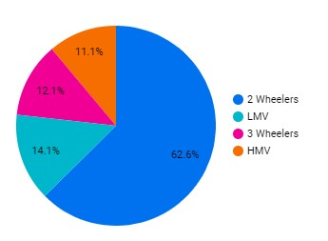
The above graph (fig. 1) shows the sale of two wheelers in India from 2011 to 2018 under reference Society of Indian Automobile Manufacturers (SIAM) India statistics, the sale of two wheelers is blatantly increasing. The energy consumption in different sector is also considered before approaching towards e-bikes, as production of electricity comes under the observation.
Energy is consumed by all types of vehicles, and according to pie chart (fig. 2) demonstrated above shows the large area for 2 wheelers vehicles. Whereas e-bikes are purposely proposed for pollution free environment. According to department of transportation e-bikes can go around 500+ miles and total charging time can vary from 2- 12 hours.

Slide 8
Literature Review
The invention of the first model electric vehicle is attributed to various people. In 1828, Ányos Jedlik invented an early type of electric motor, and created a small model car powered by his new motor. Between 1832 and 1839, Scottish inventor Robert Anderson also invented a crude electric carriage. In 1835, Professor Sibrandus Stratingh of Groningen, the Netherlands and his assistant Christopher Becker from Germany also created a small-scale electric car, powered by non-rechargeable primary cells.
Electric vehicles first appeared in the mid-19th century. An electric vehicle held the vehicular land speed record until around 1900. The high cost, low top speed, and short-range of battery electric vehicles, compared to 20th century internal combustion engine vehicles, led to a worldwide decline in their use as private motor vehicles.
.

Slide 9
Although electric vehicles have continued to be used in the form of loading and freight equipment and public transport – especially rail vehicles.
At the beginning of the 21st century, interest in electric and other alternative fuel vehicles in private motor vehicles has increased due to growing concern over the problems associated with hydrocarbon-fueled vehicles, including damage to the environment caused by their emissions, and the sustainability of the current hydrocarbon-based transportation infrastructure as well as improvements in electric vehicle technology.
In 1834, Vermont blacksmith Thomas Davenport built a similar contraption which operated on a short, circular, electrified track. The first known electric locomotive was built in 1837, in Scotland by chemist Robert Davidson of Aberdeen. It was powered by galvanic cells (batteries). Davidson later built a larger locomotive named Galvani, exhibited at the Royal Scottish Society of Arts Exhibition in 1841.

Slide 10
The 7,100-kilogram (7-long-ton) vehicle had two direct-drive reluctance motors, with fixed electromagnets acting on iron bars attached to a wooden cylinder on each axle, and simple commutators. It hauled a load of 6,100 kilograms (6 long tons) at 6.4 kilometers per hour (4 mph) for a distance of 2.4 km (1.5 miles). It was tested on the Edinburgh and Glasgow Railway in September of the following year, but the limited power from batteries prevented its general use. It was destroyed by railway workers, who saw it as a threat to their security of employment.

Slide 11
Objectives
When we drive for long distance ,their will be no proper charging station and takes more time. So when we use the self recharging vehicle we can solve this problem.
By using electric motor, when we stop accelerating, the electric motor , it acts as generator and used to charge the battery and also act as breaking, to slow down the vehicle
It is eco friendly (no pollution) and easy for construction compared to other vehicles.

Slide 12
Methodology
1) Principal of Magnetic Induction
The induction of an electromotive force by the motion of magnets across a conductive material by a change in magnetic flux in a magnetic field is called “Electromagnetic Induction‟.
Based on the principle of the Electromagnetic Induction , we transform the front wheel of the EV into a system by positioning the magnetic field and the conductor in it, where the magnetic field is varying and the conductor is stationary or vice versa. When the EV is in motion, the wheel is also in motion. So the magnetic field around the conductor varies which generates an EMF (electro motive force) and current is generated.

Slide 13
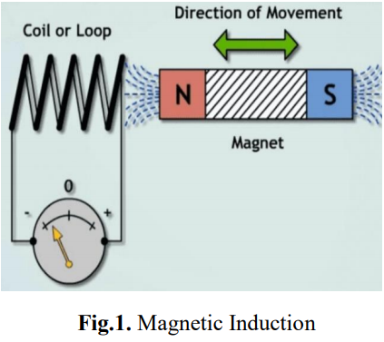
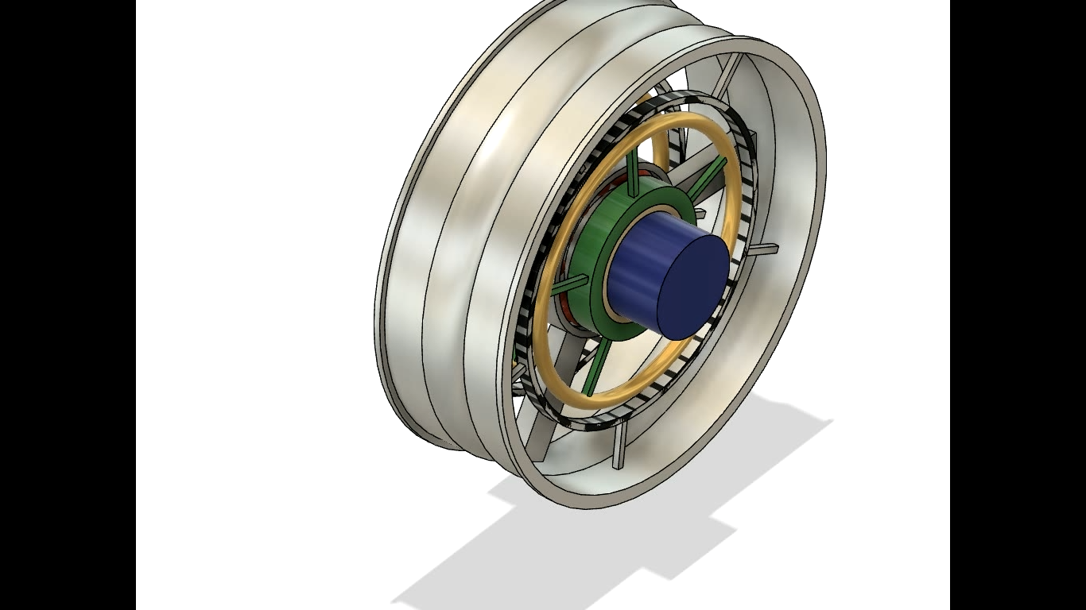
This current can be used in recharging the same battery or the backup battery used for other purposes. This recharging of the battery will for sure increase the travel range of the EV and save the battery cycle life.

Slide 14
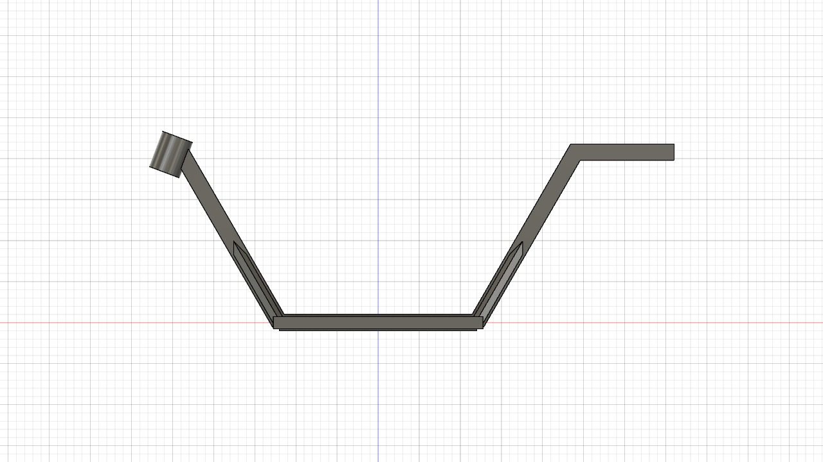
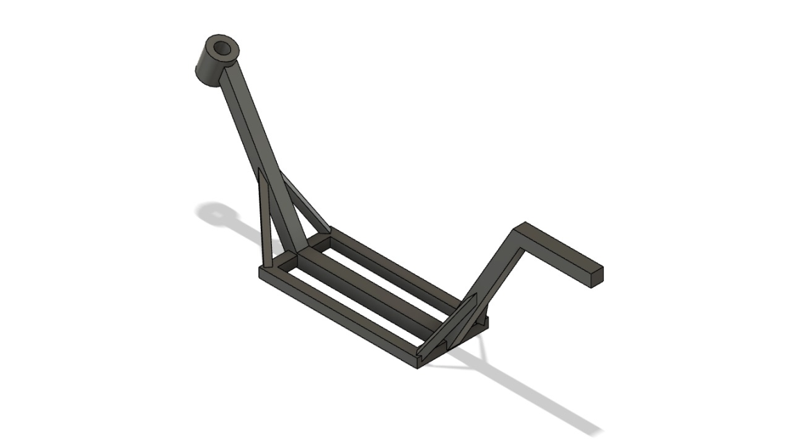
Components
1.Chassis
Chassis is the load bearing framework of an artificial object, which structurally supports the object in its construction and function.
•In chassis steel is the most commonly used material in vehicle frames.
•Carbon or high tensile steel is strong, long-lasting steel.
•Chassis material is made of carbon steel and aluminum alloy because which is light in weight.
According to our requirements and keeping all the parameters in account we will design the best suitable chassis.

Slide 15
2. Battery
A battery is a device consisting of one or more electrochemical cells with external connections for powering electrical devices.
When a battery is supplying electric power, its positive terminal is cathode and negative terminal is anode.
Nowadays, in electrical vehicles lithium batteries are being used.
According to our requirements we have selected lithium-iron phosphate battery because,
It has a good energy density at 90-120 wH/kg
Its life cycle is 1000 to 10000
Its storage is longer as it has 350 days self-life
It is safer than other batteries
It has thermal and chemical stability
Less expensive comparatively other lithium batteries
Its material can be reused.
Applications
Electrical vehicles, medical device, military applications.

Slide 16
3. Electric motor
An electrical motor is an electrical machine that converts electrical energy in to mechanical energy.
Types of Electric Motors.
Hub-brushless motor: A brushless motor utilizes a permanent magnet as its external rotor or internal rotor.
Hub-brushed motor: a brushed motor uses a configuration of wound wire coils the armature acting as a two pole electro-magnet.
Modern e-bikes all prefer to use "brushless" hub motors, because they are more durable and less expensive than the “brushed” counterpart, besides the maintenance cost in them is also very low.
4. Specification of brushless hub motor
Motor type: BLDC-hub type
Power rating: 350W
Voltage: 36V
Load: 200kg
Speed: 835.88rpm
Weight: 10kg (max)
Wheel size: 10 inch diameter

Slide 17
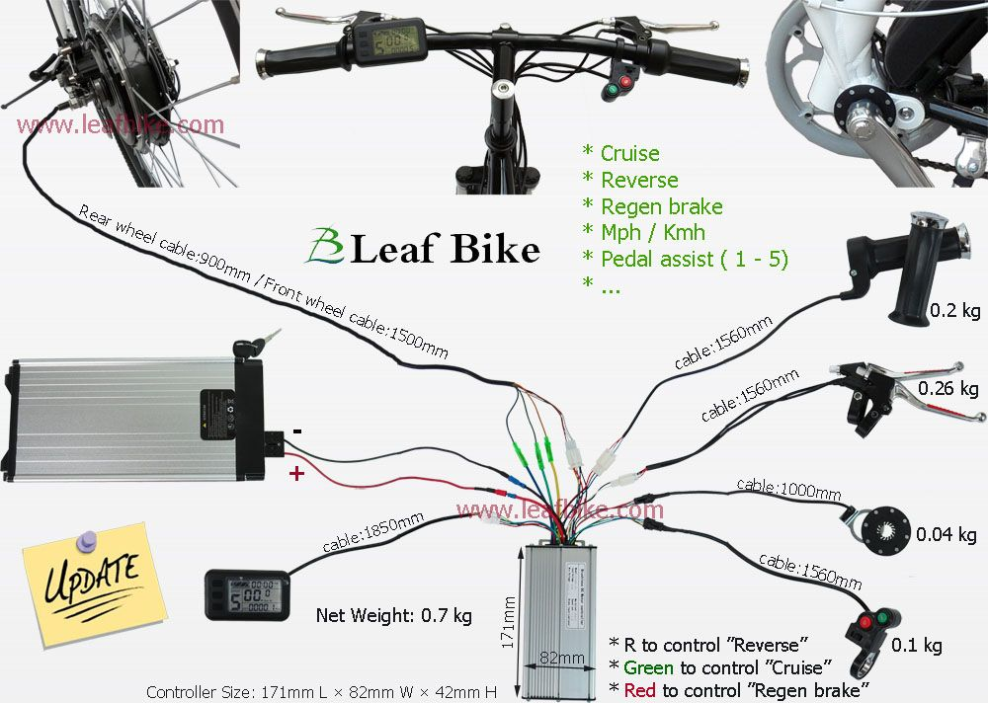
5. BLDC Motor controller
Brushless motors are not self-commutating, and hence are more complicated to control.
BLDC motor control requires knowledge of the rotor position and mechanism to commutate the motor. For closed-loop speed control there are two additional requirements, measurement of the motor speed and/or motor current and PWM signal (Pulse-width Modulation signal) to control the motor speed and power.

Slide 18
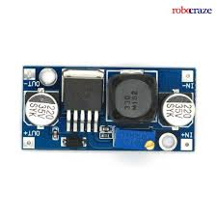
6. Buck converter
A buck converter (step-down converter) is a DC-to-DC power converter which steps down voltage (while stepping up current) from its input (supply) to its output (load).
The battery which we use have 48V power supply, but LED needs 1 to 3 V and it varies according to color so we use buck converter here.

Slide 19
Progress of The Work
Progress till now
In our project of Electrical vehicle the most important common components are electrical motor ,battery and chassis .In the electrical vehicle commonly people are confused about selecting which type electrical motor ,battery and design of chassis to be used .
So firstly we done the research/study on the electrical motor which is suitable for the our electrical vehicle. Based on our research ,we get know that hub motor is the suitable for EV which directly attached to rim of the tyer ,brushless motor their will be less power losses ,so we selected the hub motor.
Than we done the research on the battery which one is better, than we selected the lithium iron phosphate battery because it is economical compare to other lithium battery but we get same effective as getting in the lithium battery nowadays
After that we designed chassis at the starting by the use of app fusion 360 from Autodesk
The chassis diagram is given below fig1

Slide 20
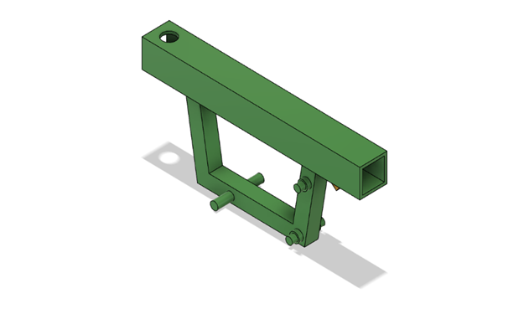

Figure 1
But due to the issue in placing the battery ,so we modified the chassis and it is given below figure 2

Slide 21
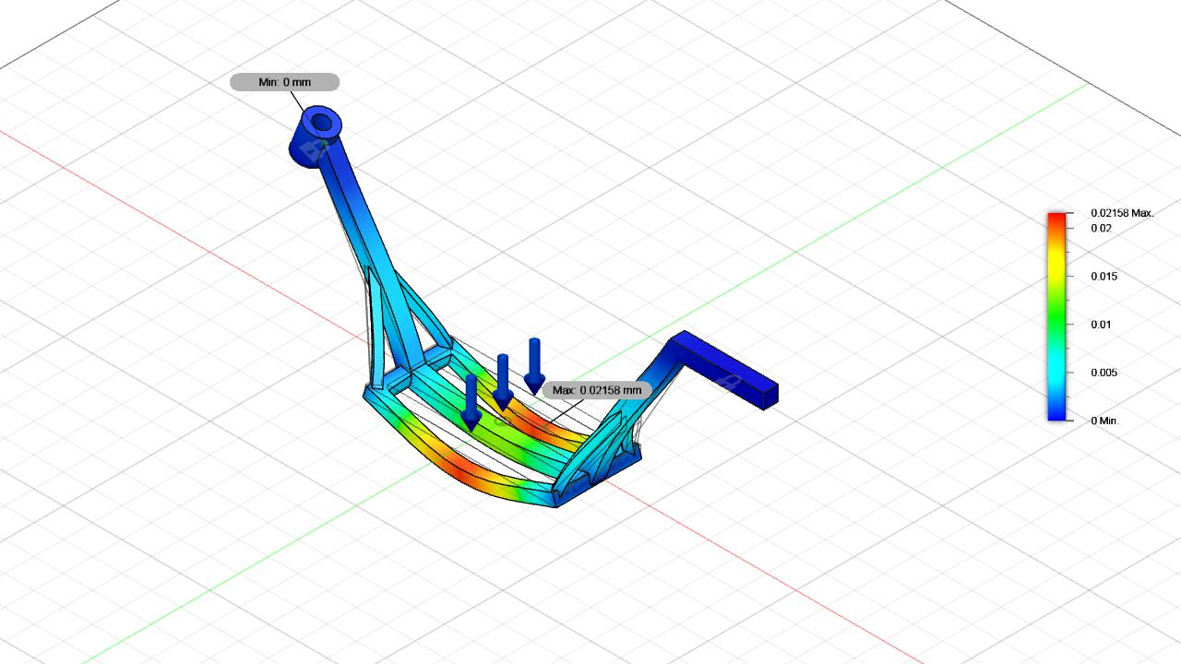
What to do next
We are analyzing and trying to modifying the chassis and we are doing the simulation on the chassis .The simulation diagram of the chassis is given below figure 3
Figure 3
From the above simulation ,if we apply the 200kg load to center of the chassis than their will be 0.02mm displacement .

Slide 22
By using the simulation we are learning and trying to bring modification in chassis design .
Than we are trying to get the maximum voltage by trying the combination of series and parallel of the battery cells.
Lastly we are going to do the fabrication at an economic price and we finding the parts which are pre used which reduces our expenses

Slide 23
Conclusion
The generated current will be stored in the battery and can be used again to run the Electric Vehicle and for various purposes like Head light, indicators and starters. . By different combinations of the the windings and the strength of the magnet we can obtain the desired output. The travel range of the Electric Vehicle will increase. This will save a lot of energy with no pollution what so ever. The charging time of the battery will be reduced drastically as the battery is continuously self-recharging and it will prove to be helpful for long distances commutators as they don’t have to search or stop the EV for a charging station and wait for 2 – 12 hrs till the battery gets completely charged.

Slide 24


